Slide 1
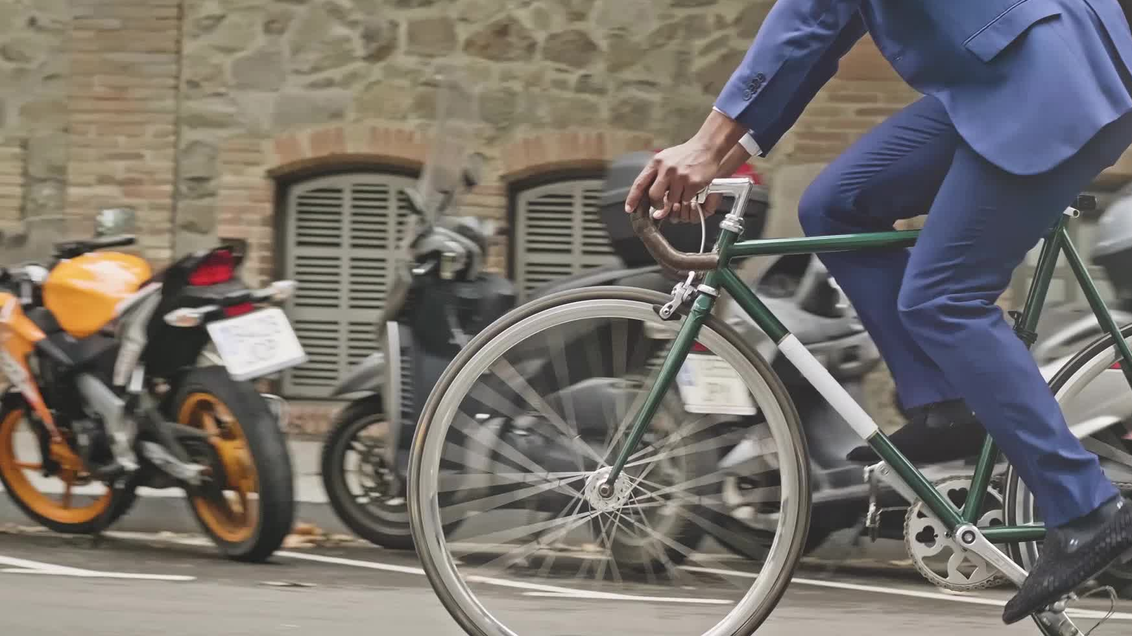


Exploratory Data Analysis on the Bike Buyers Dataset
Using Shiny App
1.Damarla Sree Sowmya (WIN:947748354)
2. Surya Sudarshan Ryali (WIN:031842368)

Slide 2
Contents
Introduction
Objective
Dataset Location
Overview of Design
Process Control
Program Snippets
Outputs
Conclusion

Slide 3

Introduction
A user can use a variety of transportation options to get around for a variety of reasons. They may decide on that mode of transportation based on a variety of observations and personal preferences. A bicycle is an excellent model of transportation for a variety of reasons.
The main aim is to reduce the congestion, noise, and air pollution in the urban areas by equipping free and affordable access to bicycles for short-distance trips as contradiction to motorcycles.
To begin with, as contrasted to a vehicle or any other privately possessed vehicle, bikes are handier and more cost-effective as a private transport that one can afford.

Slide 4
As the population is rapidly increasing by every year the usage of cars and other vehicles are gradually increasing as a result of this the pollution has become a major concern worldwide. To avoid this bicycles are the best means of transport to reduce the greenhouse gases.
A willing buyer has several factors by which he or she can be determined as a true buyer because There is a multitude of related factors that come along with the bike purchase.

Slide 5
Objective
The main objective is that we will utilize a dataset encompassing numerous parameters before purchasing a bike in our suggested research.
As a result, our primary goal is to comprehend the criteria and determine whether a buyer has a bicycle or not.
In this we can know the maintenance of the bikes and their cleaning efficiency.
The proposal also talks about private vehicles basic for the identification of destination and ways to reach there.

Slide 6
The destination of the biker needs to be reached quickly and therefore this efficiency can only be made in flexible ways.
Bikes are convenient and are owned personally as a very pocket-friendly vehicle.
It is about the fact that one can afford it so easily, making it the most efficient and comfortable transport.

Slide 7
Dataset Location
Bike Buyers Dataset was used, and it was obtained from Kaggle's Repository and it is used for identification of the data set and utilizing it.
This is also known as the data set for the bike buyers and it is being collected very specifically and precisely from the repository.

Slide 8
Overview Of Design
In this, we will do a complete Exploratory Data Analysis (EDA) here in order to understand numerous elements, and, as a result, we will focus on determining whether a customer should purchase a bike based on those criteria.
To achieve the aim and objective of this suggested study, we will use the R development platform.
The design brings over the performance of a detained time of exploratory data analysis.
Many correlated factors are also to be understood along with the objectives that are determined for the proposed work.

Slide 9
Data Visualisation
Data visualization is the graphical representation of information and data. By using visual elements like charts, graphs, and maps, data visualization tools provide an accessible way to see and understand trends, outliers, and patterns in data.
R is an amazing platform for data analysis, capable of creating almost any type of graph. This book helps you create the most popular visualizations - from quick and dirty plots to publication-ready graphs.
The text relies heavily on the ggplot2 package for graphics, but other approaches are covered as well.

Slide 10
Exploratory Data Analysis
For this suggested EDA job, a significant amount of effort is required, in which we will first examine the information and then identify distinct elements and process them for analysis depending on our observations.
Then, in order to have a clear knowledge of the profound knowledge of the overall goal of the project, a quantitative assessment will be carried out. The suggested work might take between three and four-month to finish.
Based upon the given features EDA is done
1)Marital Status
2)Gender
3)Occupation
4)Region
5)Education

Slide 11
We have Performed Exploratory data analysis using the Bar Plot.
Slidebar Panel has helped us to visualize the bike buyers based upon the parameters throughout the years.
The Income Varies between $10,000 to $20,0000.
We have taken the inputs between count vs vehicles and plotted the bar.

Slide 12
Data Manipulation
Data Manipulation allows for function chaining, preventing any potential cluttering in the code, which in turn makes for easier code writing/reading.
We have Done the data manipulation process using the dplyr library.
In this project we have used the functions like sort,filter and select to operate the data.
As there are many rows in the dataset we need to modify them and leverage the data to obtain in-depth insights and make better business decisions.
Data Manipulation allows for function chaining, preventing any potential cluttering in the code, which in turn makes for easier code writing/reading.

Slide 13
Shiny aPP
Shiny is an R package that makes it easy to build interactive web apps straight from R. You can host standalone apps on a webpage or embed them in R Markdown documents or build dashboards.
Shiny combines the computational power of R with the interactivity of the modern web.
It defines the user interface, the HTML webpage that humans interact with. In this case, it’s a page containing the words “Hello, world!”.

Slide 14
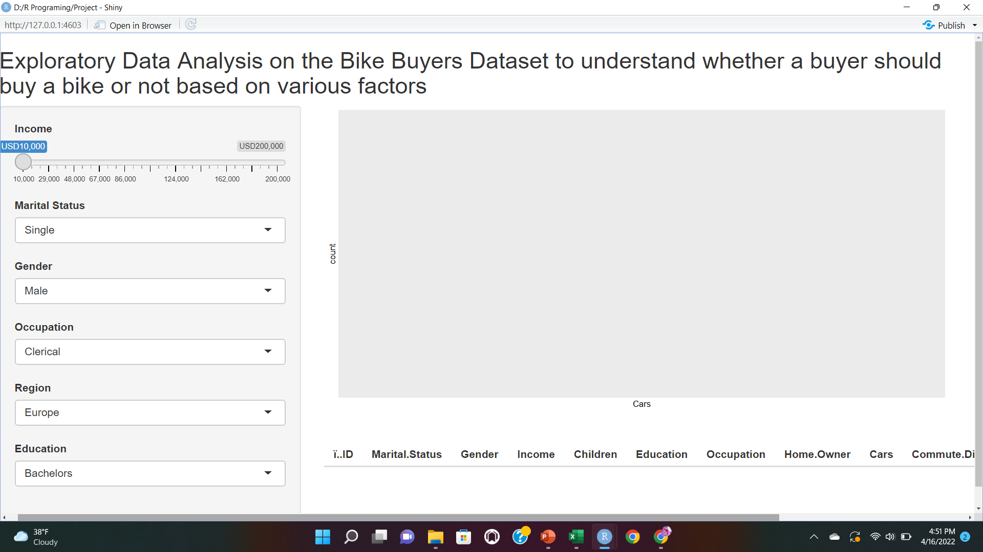
This is a sample where we can retrieve the information throughout the years by varying the following parameters.

Slide 15
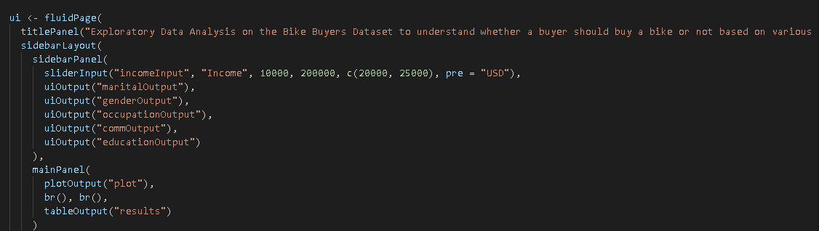
The below code represents the user interface of the program with the features of the dataset

Slide 16
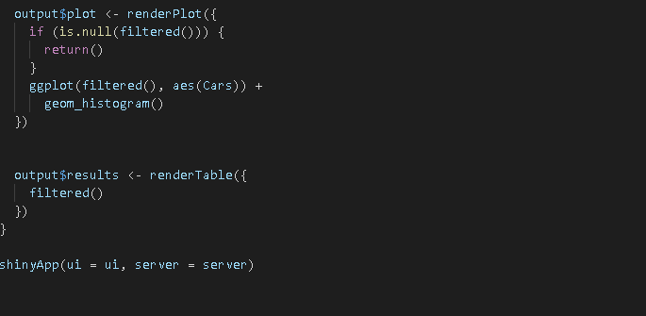

Slide 17
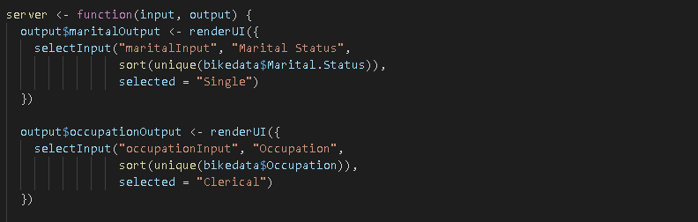
The below code shows about the hosting of the website

Slide 18
Conclusion
Here we have created shiny application to determine the result in an easy way. So, this process of analysing is helpful to obtain a perfect solution.
In this project, we have obtained the datasets from Kaggle which has been used for identification of the data.
The end goal of this project is to improve the bike sharing activities and support the reinvention of the urban transportation system.

Slide 19
Thank You

